Slide 1
Does Power Corrupt? An fMRI Study on the Effect of Power and Social Value Orientation on Inequity Aversion
Loren Pauwels, Carolyn H. Declerck, Christophe Boone,Paloma Diaz-Gutiérrez, and Bruno Lambert Faculty of Business and Economics, University of Antwerp
报告人：韩佳豪

Slide 2
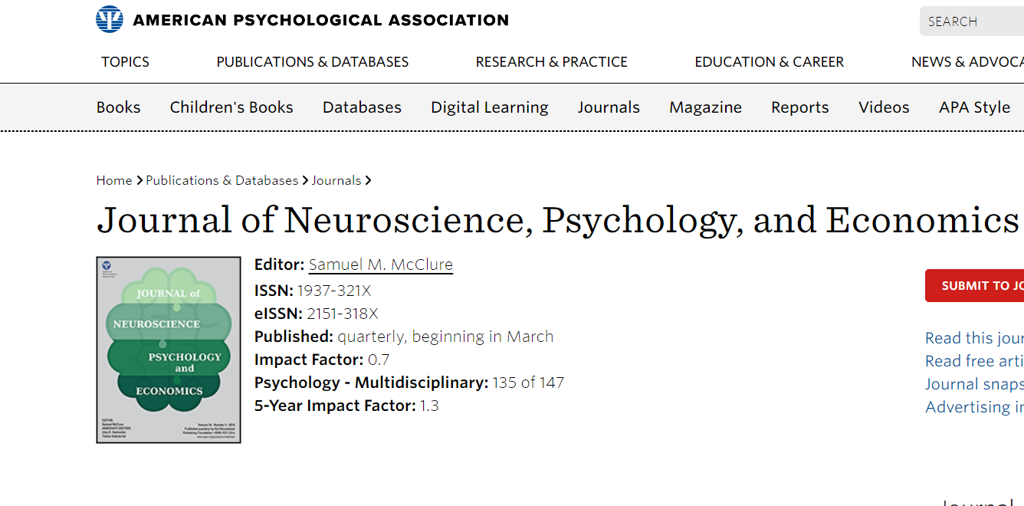

Slide 6
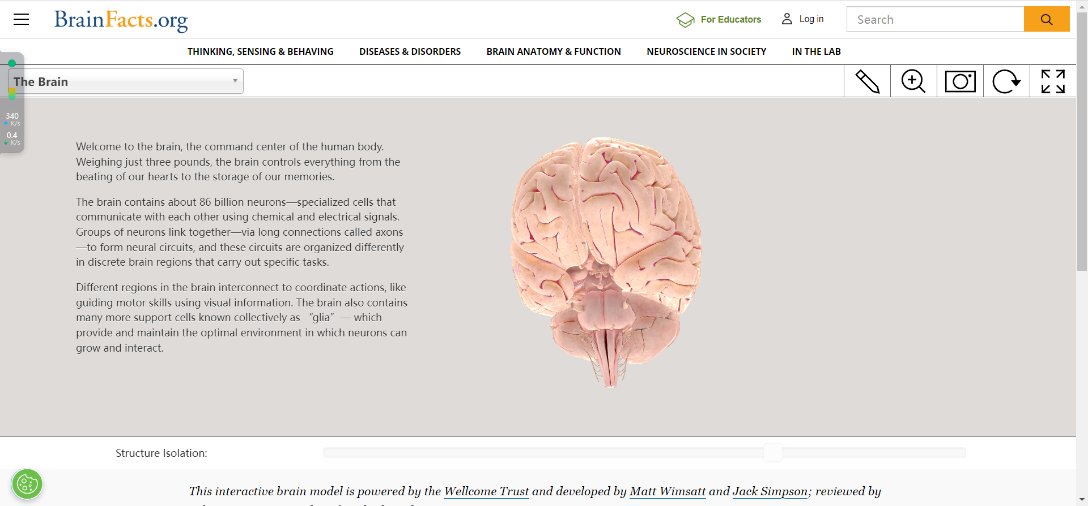
https://www.brainfacts.org/3d-brain#intro=false&focus=Brain&zoom=false

Slide 7
理论背景
THEORY

Slide 8
01
PART
引言——理论背景
INTRODUCTION
Equality is a benchmark across human societies and violations of the equality norm are ubiquitously disliked and punished. Despite this well documented universality (e.g., Henrich et al., 2006), there is considerable heterogeneity in the extent to which people are inequity averse and willing to set aside self-interest in support of equal outcomes (e.g., Fehr & Schmidt, 1999).
There is accumulating evidence that the resulting aversion to disadvantageous inequality (DA-IE不利不平等) and advantageous inequality (A-IE有利不平等) is substantially different.
While a confrontation with both DA-IE and A-IE is expected to elicit emotions and activate social comparison (and hence mentalizing), aversion to DA-IE is naturally stronger than to A-IE (Fehr & Schmidt, 1999; Loewenstein et al., 1989), and the two correlate only weakly (Chapman et al., 2018).

Slide 9
01
PART
引言——理论背景
INTRODUCTION
A well-studied factor with substantial influence on preferences for equality (and conversely, on inequity aversion) is power asymmetry. Gaining power in relationships has been shown to lead to reduced concern for others (Laurin et al., 2016; Righetti et al.,2015), lower trust (Schilke et al., 2015) and weaker reciprocation (Pauwels, 2021), while priming a position of power increases cheating during a subsequent experimental task (Cohn et al.,2014). 拥有权力会让人降低同理心
POWER：Power is here defined as a psychological state that comes with having control over others.
SOV(social value orientation):a stable trait indicating how much weight a person attaches to the distributive outcome of others in relation to their own.

Slide 10
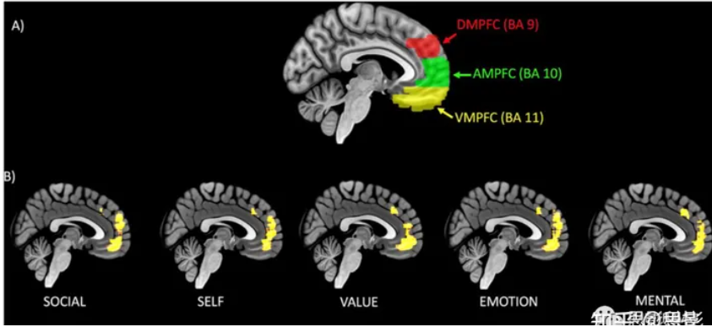
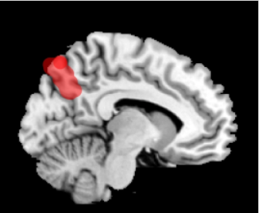
POWERxDA-IE: The tolerance for inequality in DA-IE is reduced specifically when people feel entitled. we would expect concurrent amygdala(杏仁核) and insula(脑岛) activation.
POWERxA-IE: Because power increases entitlement through increased social distance and social norms that legitimize greed, A-IE is expected to be weaker for the powerful. compared to individuals of high social status, those with a lower social status were more prone to mentalize, which corresponded with greater activity in the precuneus（楔前叶） and dorsomedial prefrontal cortex（背内侧前额叶皮层）.PS:楔前叶是顶上小叶的一部分，位于大脑半球内侧。它位于楔叶前部（枕叶上部）,与许多高水平的认知功能有关，如情景记忆，自我相关的信息处理，以及意识的各个方面. 社会过程在功能上与dmPFC 相关

Slide 11
01
PART
引言-问题假设
INTRODUCTION
2 (group: POWER） × 2 (DA-IE；A-IE) × 2 （SOV：proselfs；prosocials）
Hypothesis 1: In DA-IE, having power over others increases inequity aversion↑. At the neural level, processing inequality when having power is associated with increased activation in brain regions involved in emotional aversion, namely, the insula and amygdala.
Hypothesis 2a: In A-IE, having power over others decreases↓ inequity aversion. At the neural level, processing inequality when having power is associated with decreased↓ activation in brain regions associated with higher order cognitive control (dlPFC背外侧前额叶) and mentalizing functions (TPJ颞顶联合区, dmPFC背内侧前额叶, precuneus楔前叶).
Hypothesis 2b: In A-IE, having power over others reduces↓ inequity aversion especially for proselfs. At the neural level, for proselfs having power, processing inequality is associated with decreased降低↓ activation in cognitive control regions of the brain (dlPFC). For prosocials having power, processing inequality is associated with increased activation in these regions.
Ｂａｃｋ2
Ｂａｃｋ

Slide 12
FMRI检验
To address Hypotheses 1 and 2a, contrasts were calculated according to power role, namely, [TeammateDA-IE×Difference>baseline >LeaderDA-IE×Difference>baseline], [LeaderDA-IE×Difference>baseline > TeammateDA-IE×Difference>baseline]
the same contrasts substituting DA-IE with A-IE（AE处理同上）. These contrasts reveal the interaction effect of role (teammate/leader) and the magnitude of inequality on the BOLD signal when the processed inequality is respectively disadvantageous or advantageous.
Finally, we tested the effect of the power role on the BOLD signal given a participant’s SVO (i.e., Hypothesis 2b). We repeat the second level contrast separately for proselfs and prosocials: [ProselfsTeammateAIE×Difference>baseline > Proself LeaderAIE×Diference>baseline] and [Prosocial TeammateAIE×Difference>baseline>Prosocial LeaderAIE× Difference>baseline].

Slide 13
方法 实验
METHOD

Slide 14
02
PART
方法-参与者与程序
METHOD
40 Forty healthy volunteers (university students from different departments, with average age =22 years, SD = 2 years) participated in the scanning sessions of the experiment. Based on questionnaire ,participants were selected to balanced for gender and SVO.
Procedure:
(a) generating ideas for a creativity task, which was a part of the power manipulation prior to scanning, (b) evaluating reward pairs between self and other in the MRI scanner, (c) completing the creativity task and postscanning questionnaire.

Slide 15
Participants were assigned one of two possible roles. The leader(high power) or the follower(low power) .Roles were balanced over SVO,
Proselfs prosocials
Leaders proselfs X leaders prosocials X leaders
Followers proselfs X followers prosocials X followers
Pariticipants need come up with 1000 creative way to use pipe, “leader” were told
(a) evaluate the creative ideas provided by their follower
(b) decide on the best creative idea (either their own, or that of their follower) which would be submitted to a jury,
(c) determine how to divide a 19€.
Followers had no control over the outcome of the creativity task, but they were compensated in truth based on leaders’ decisions.

Slide 16
In the scanner, participants observed and rated a series of 36 hypothetical distributions of a sum of money split between themselves and the anonymous person with whom they were matched in the creativity task.
Half of the distributions yielded an advantage to the participant, while the other half yielded a disadvantage. Hence DA-IE and A-IE was a within factor in the experiment, while the assumed power position (leader or teammate) was a between factor.
(a) “What is your role in the creativity task? Press left for leader–press right for subordinate”
(b) “Do I get to see the creative ideas of my subordinate? Press right for yes–press left for no”;
(c) “Do I have to evaluate my subordinate on their ideas? Press left for yes–press right for no”;
(d) “Do I get to decide on the compensation for this task? Press right for yes–press left for no.”
Finally, during the actual evaluation task, participants were again reminded of their roles in each of the 36 trials through the labels above the money allocations (“me” and “subordinate” or “teammate”).

Slide 17
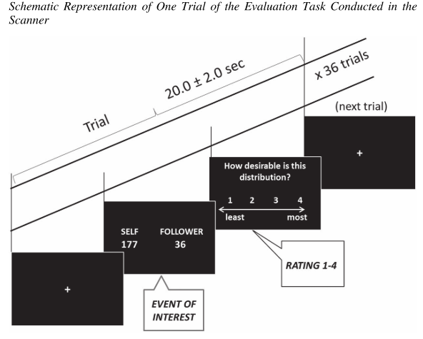
In the last frame (the response phase), participants were asked to rate each distribution on a scale from 1 to 4 (least to most desirable), yielding a “liking score” (the inverse of inequity aversion), the dependent variable in the behavioral analyses.

Slide 18
数据的预处理
Images were gathered with a Siemens MR Prisma scanner and an eight-channel head coil (30 slices per image, TR = 2 s).
The image analysis was conducted with the statistical parametric mapping package (SPM12; Wellcome Department of Cognitive Neurology, London).
During preprocessing, images were
(a) corrected for slice timing,
(b) realigned对齐
(c) normalized against the Montreal Neurologic Institute (MNI) template and 标准化
(d) spatially smoothed (full width half maximum=7mm)and (e) temporally filtered with a 128 s high-pass filter 平滑处理
在扫描结束后向被试发放问卷，让被试完成创造性任务的后半部分并且询问被试作为领导、追随者的体验，以确保“权力”这一变量操纵的有效性。t检验证实了领导者比队友感到更强大(t = 2.7, p < .01, Cohen’s d = 0.854)。

Slide 19
结果 行为部分
RESULTS

Slide 20
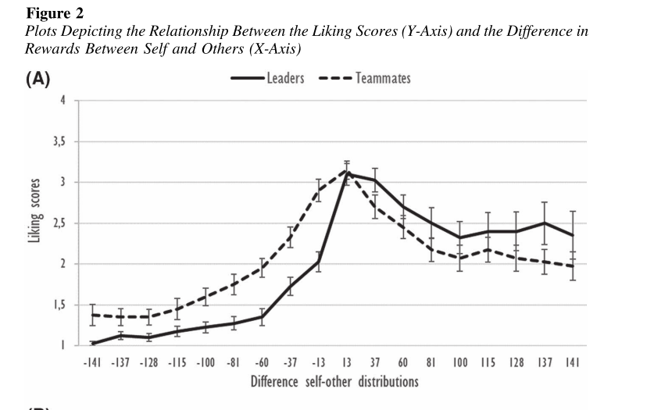
plot the mean liking scores (+/− standard error) of all individuals against the difference in reward to self and other (See Figure 2)。
可以看到有权者更不喜欢DA—IE而且更为偏好A—IE。

Slide 21
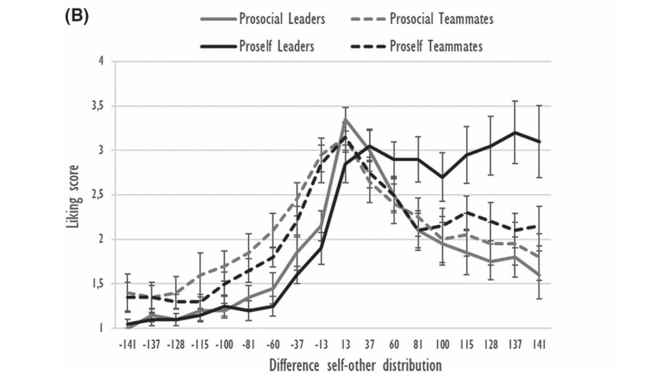
Figure2B shows the same plots decomposed according to SVO. Here a three-way interaction between inequality, power, and SVO manifests itself in A-IE
随着不平等的加剧，自利型领导者并不会变得更加厌恶不平等(他们会保持较高的好感度)。对于薪酬差异较大的群体(>100)，自利领导者的不平等厌恶程度较低，呈现出一条向上倾斜的曲线，这与其他三种群体明显不同。相比之下，亲社会的领导者则表现出一条向下倾斜的曲线(不喜欢不平等)，很像队友。在DA-IE中未见这种交互作用。

Slide 22
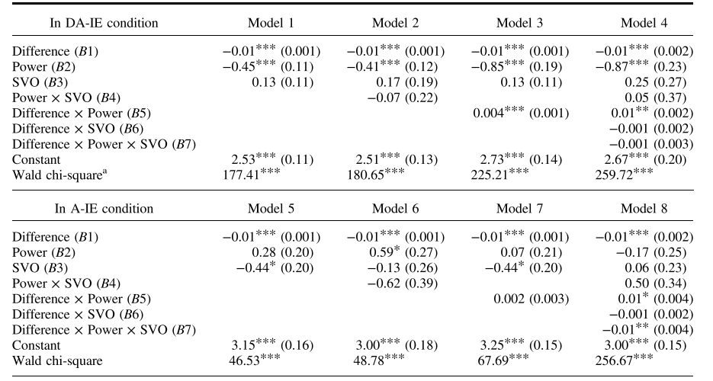
使用GLS广义最小二乘法模型对行为数据进行分析并建立８个模型，１－４是DA—IE条件，５－８是A—IE条件。差异给出的是B值，括号内为标准差，＊号代表显著性水平
The main effects of power (coded 1 for high power, 0 for control) and SVO (coded 1 for prosocial, 0 for proself) are tested in model 1, controlling for the effect of varying sizes ofinequality (denoted “Difference”)

Slide 23
the larger the difference in rewards between self and other, the more negative the liking scores (B1 = −0.01, p < .001). Individuals in a powerful position indicated overall lower liking scores (B2 = −0.45, p < .001). Model 1 furthermore indicates no effect of SVO.
证明了假设１
权力对喜好得分的负面影响随着不平等程度的增加而减弱(模型3,B5 = 0.004, p < .001)。
假设

Slide 24
Models 5–8 relate to Hypothesis 2a and Hypothesis 2b
controlling for varying sizes of inequality which significantly affect liking scores (B1 = −0.01, p < .001). In this model, power does not affect liking scores on top and beyond the effect of reward differences, contradicting Hypothesis 2a.推翻２ａ
SVO发挥了一定的作用:亲社会者相对于自我者，总体上好感度得分较低(B3=−0.44,p = 0.027, Bonferroni校正p = 0.081)
Models 6–8 report on the interaction effects that relate to Hypothesis 2b. Of particular interest is Model 8, which tests the postulated three-way interaction between power, SVO and reward Difference. Corroborating Hypothesis 2b, power appears to influence liking scores for increasingly A-IE only for proselfs (B7 = −0.01, p = .003, Bonferroni corrected p < .021).
假设

Slide 25
结果 神经部分
RESULTS

Slide 26
not show the hypothesized insula- or amygdala activation as a function of increasing inequality in high power participants. Instead, teammates (relative to leaders) show more activation in regions labeled as left and right superior parietal lobule (SPL) when confronted with increasing DA-IE 左右上顶叶(SPL)的区域表现出更多的激活，脑岛和楔前叶没有激活。假设１被否定
Unfortunately, the whole brain contrast maps suffered from signal disturbance around the ventricles, resulting in loss of data for functional amygdala activation杏仁核数据丢失
Neither for the anterior nor posterior parts of the insula did significant differences between groups emerge.脑岛未被激活

Slide 27
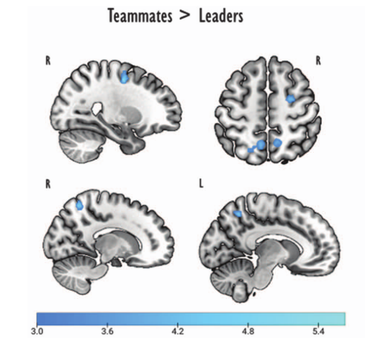
在A-IE条件下，相比于追随者，领导者表现出三个区域的活动减弱。Ａ右中央前回(坐标:26 -6 50)，峰值坐标与额视野(FEF)重叠．
Ｂ左楔前叶和右楔前叶，这是顶叶皮层的一个区域，在需要社会互动的任务中几乎总是被激活，特别是当被要求采取他人的观点时(Cavanna & Trimble, 2006)。
没有一个对比显示TPJ或dmPFC假设区域的激活有差异
假设２ａ楔前叶被证明活动减弱。
假设

Slide 28
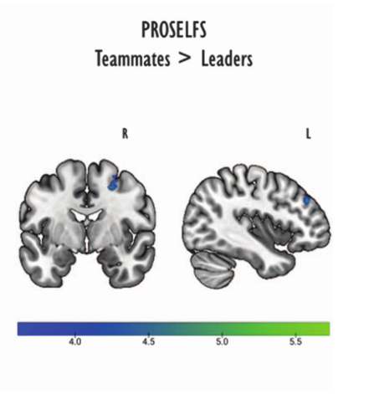
检验假设２ｂ，进行亲社会者和自利者的全脑分析，亲社会的领导与追随者没有激活模式的差异。
自私的领导与追随者在A—IE奖励差异的增加时，dlPFC中典型包含的两个区域的BOLD信号呈负相关。A右侧额上回的外侧和后部(坐标:22 −4 50)
B左侧额中回前部、背外侧部分(坐标:−42 38 32)。
假设2B得到了部分的证实:神经数据与自我认知控制的减少相一致，但没有证据表明亲社会者的认知控制增加。
假设

Slide 29
讨论
DISCUSSION

Slide 30
①The behavioral data corroborate Hypothesis 1 : power significantly lowerd participants’ liking scores , but there is no evidence show that amygdala and insula are activation(due to signal loss).
②The behavioral data show a trend (Figure 2A) supporting the hypothesis that power decreases A-IE aversion (Hypothesis 2a) but this is not statistically significant.假设2a行为部分显示有趋势，但不显著。
Neural data partially show Hypothesized 2A, leaders (compared to teammates) show decreased activity in one of the hypothesized mentalizing regions (bilateral precuneus 双侧楔前叶). dmPFC and TPJ are no difference. However, high power correlates with decreased activity in the frontal eye field (FEF额叶视野), which lies adjacent to the dlPFC and is anatomically and functionally related to it.靠近dlpfc且功能相关。
③The behavioral data show when inequealities gets larger ,the effect of power would be more pronounced for proself leaders than for prosocial leaders.(交互作用显著)。
The neural data support this hypothesis that cognitive control is reduced for proself leaders (compared to proself teammates), as shown by the attenuated signal in the dlPFC. However, unlike expected, increased dlPFC is not observed for prosocial leaders (compared to prosocial teammates).

Slide 31
The FEF beyond controlling eye movements is becoming increasingly noted in cognitive tasks such as attentional orienting, consciousness, perceptual performance, inhibitory control, and decision-making。 FEF在控制眼球运动之外的作用在认知任务中越来越被注意到。FEF的激活可能与需要和他人分享利益有关，参与者需要在脑海中想象另一个人的参照框架，而很明显，对于领导者来说这种倾向更容易被抑制。
在假设2b的神经证据中，亲社会的领导者与亲社会的追随者并没有显著的差异，一种可能的解释是亲社会领导者的价值观以知觉的方式影响了参与者对A-IE的厌恶，而没有造成更多的神经变化。
不足：
①样本量n=40过小，意味着二类错误的概率上升，可能存在“弃真”。因此本研究的一些不显著结论可能是不可信的，需要进一步改进。
②权力的操纵是具有问题的，对于亲社会的领导者来说，权力这一操纵可能无效proself (t = 2.13, p = .047, Cohen’s d = 0.952)比prosocials(t = 1.45, p = .16, Cohen’s d = 0.65)。
③对于核磁的解释需要更加谨慎，因为神经反应是基于大脑网络的，之间互有连结，需要进一步的探索。

